Slide 1
Teck Ghee Arc 401

Slide 2
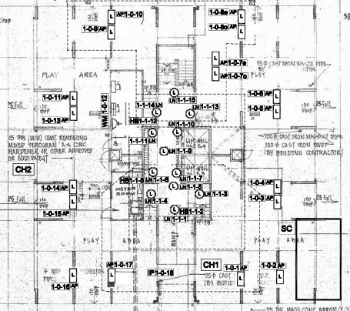
Block 401 1st STOREY FLOOR PLAN

Slide 3
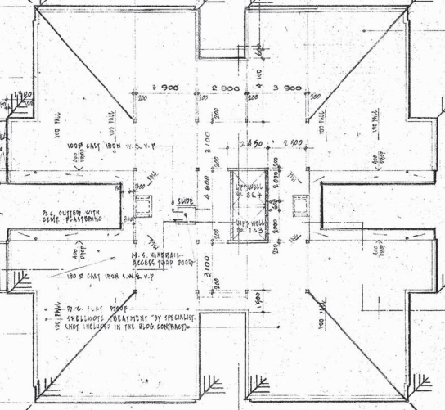
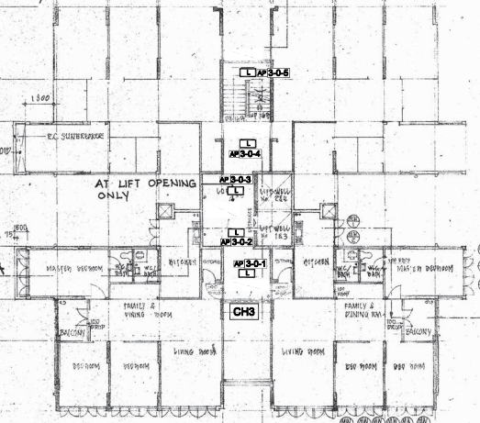
STAIR
PUMP ROOM
A
STORE
LOBBY
B
METER ROOM
SWITCH ROOM

Slide 4
Block 401 2nd TO 25th STOREY FLOOR PLAN

Slide 5
STAIR
605
607
A
LOBBY
B
COMMON CORRIDOR
603
601

